Slide 1
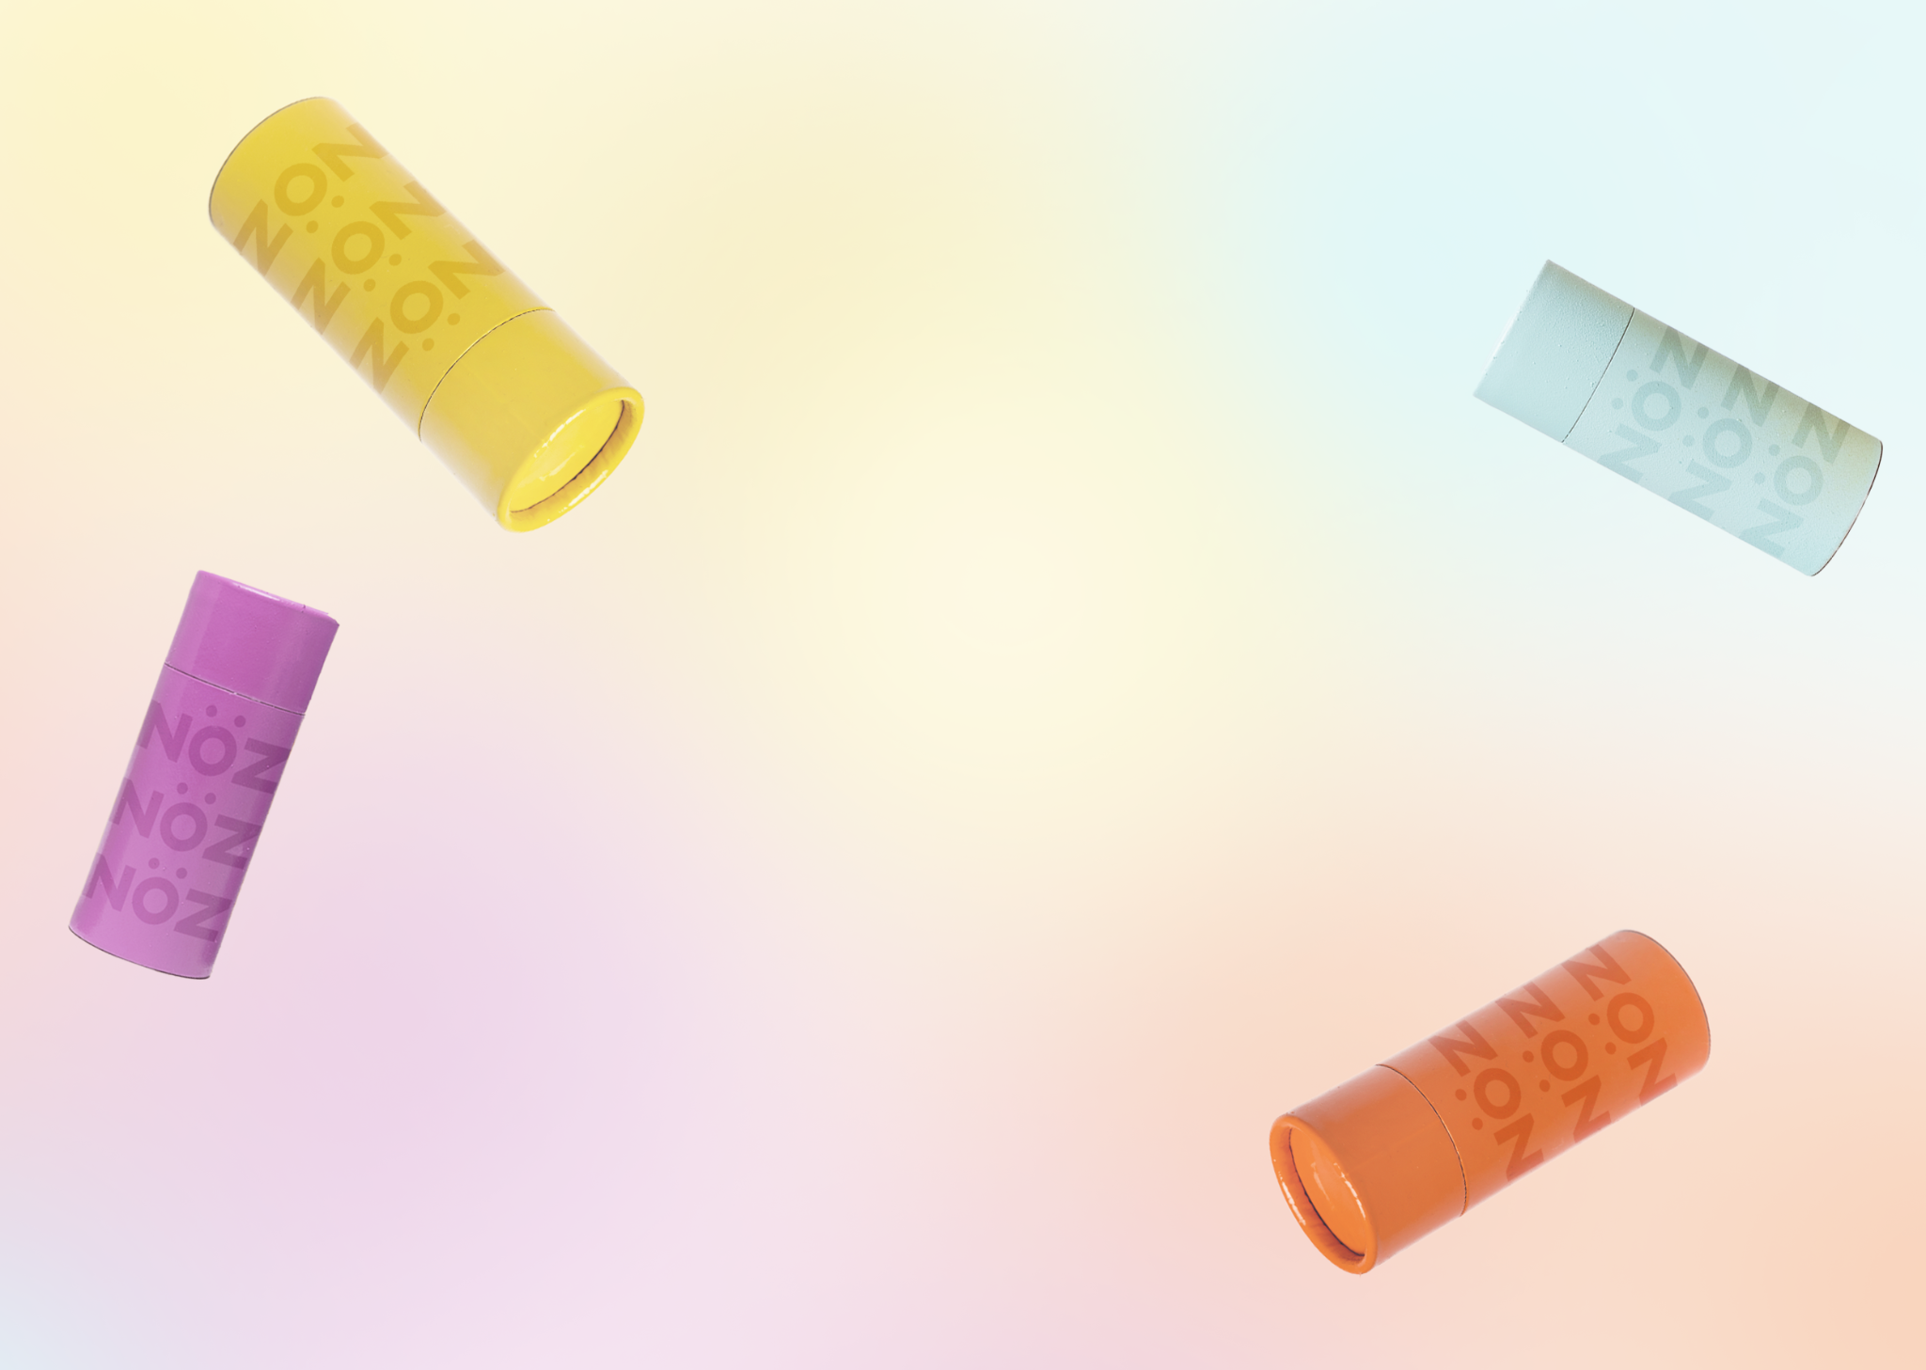
Nöz
Final Project
https://tbhq-amcmaho4-935.myshopify.com
Aarionne McMahon
02-16-2022

Slide 2
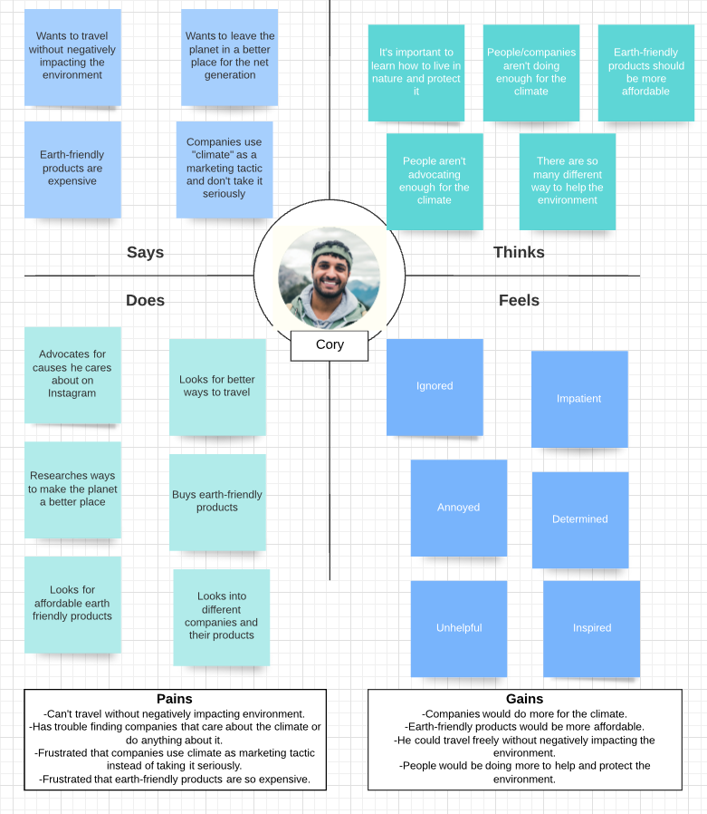
Target Customer
Cory
Nöz can help Cory because the sunscreen is made for people who love to be outside and like to travel as Cory does. Nöz is also an eco conscious company that creates affordable products for those who care about helping the environment, which Cory has mentioned is an important aspect he looks for in companies when purchasing products.

Slide 3
Value Proposition
When looking for a vegan, cruelty-free, and eco-friendly product that makes you look good and feel good, choose Nöz. Nöz is the sunscreen that will protect your skin during your everyday travels, trips to the beach, or just your casual day of fun in the sun.

Slide 4
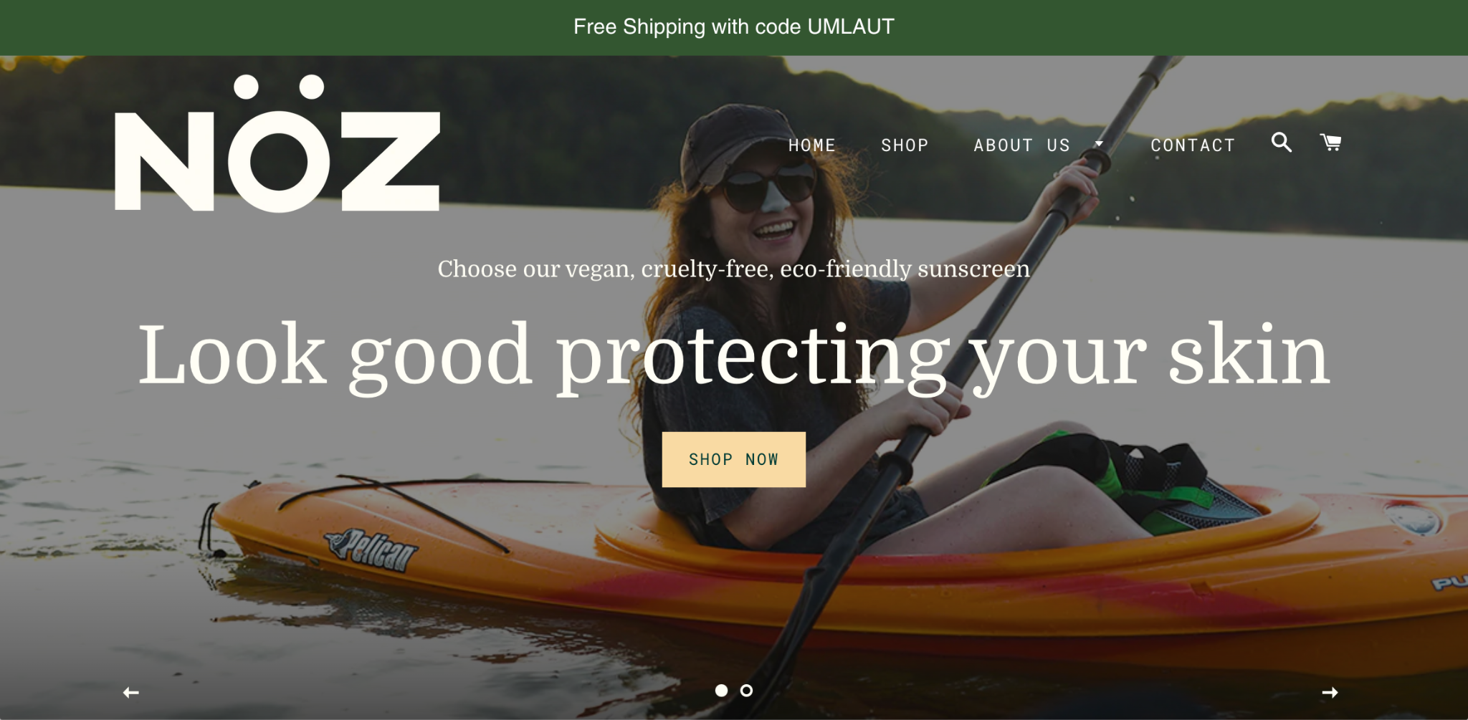
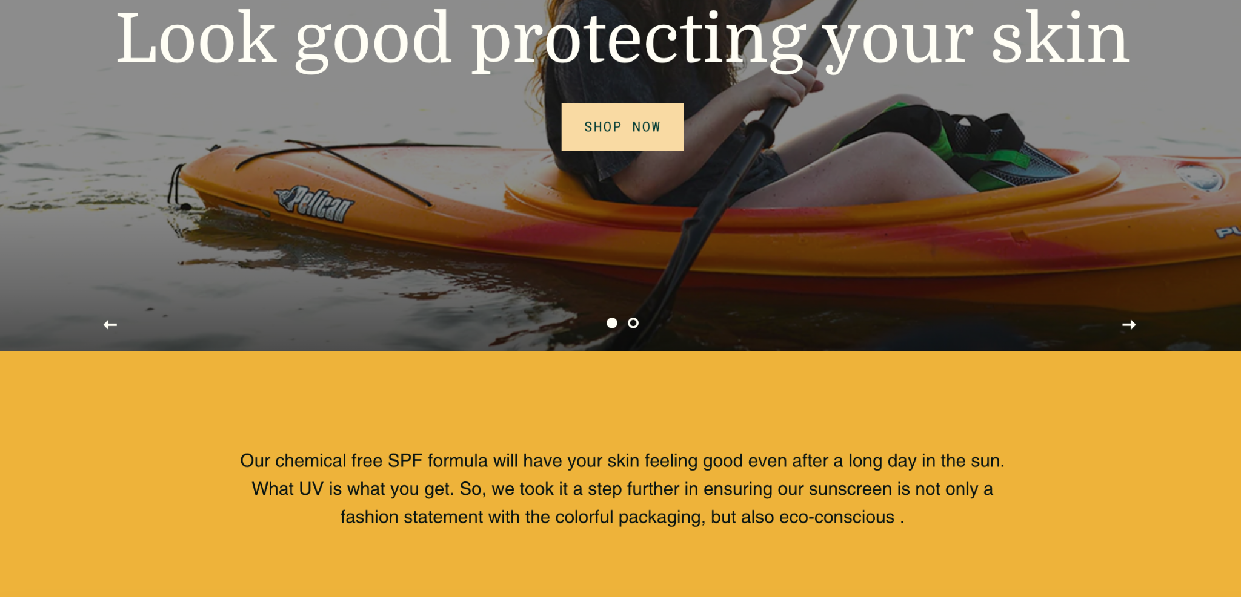
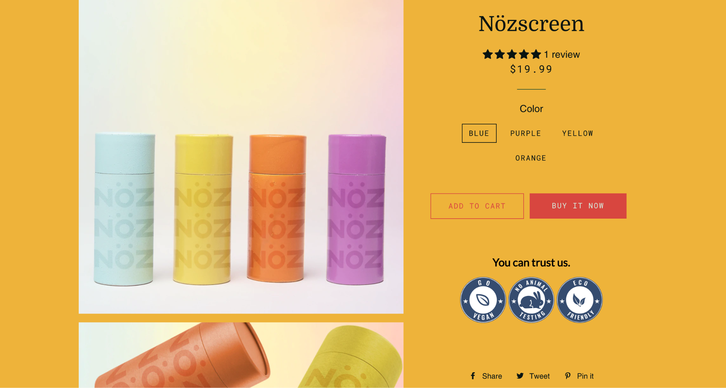
Value Proposition
The homepage, to me, was the first point of customer interaction and I thought with the customer persona in mind, it would be important to both encapsulate the eco conscious tone of the company and provide an appealing page to look at.
So, in communicating my value proposition I added text about the sunscreen being eco friendly, included images that showed people having fun outside wearing Nöz, and used earthy tones to appeal to the customer.

Slide 5
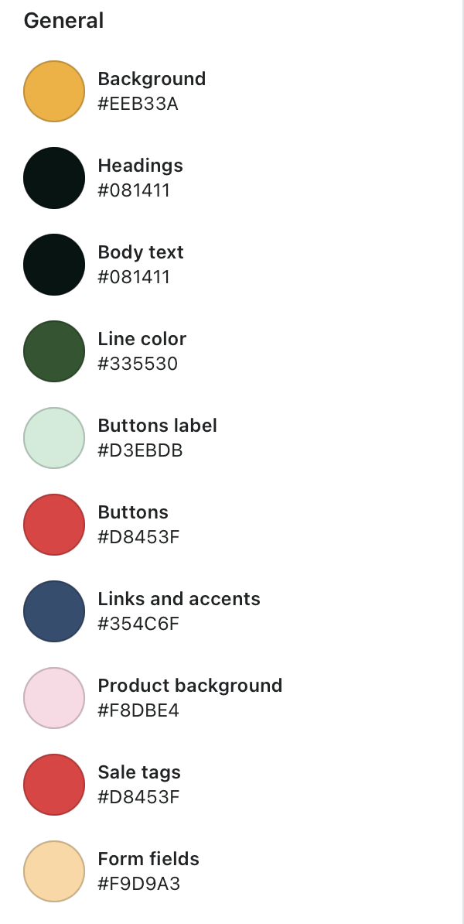
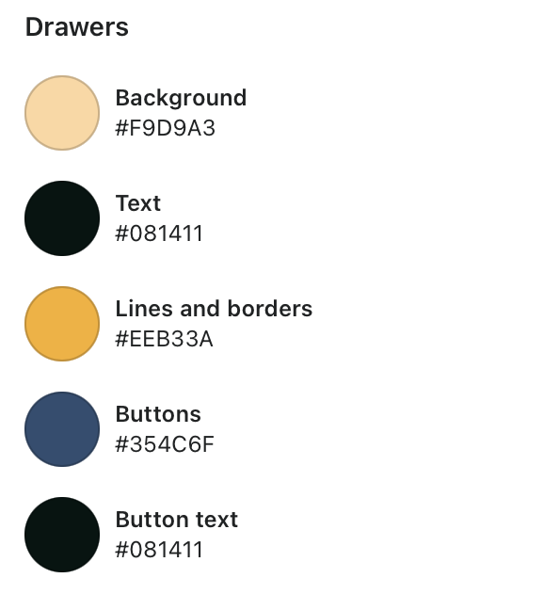
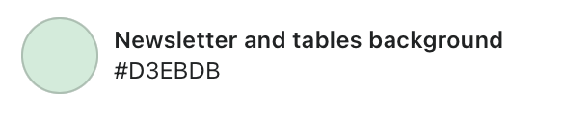
Brand Visuals - Color Palette
For the website I wanted to go for a nature feel, which is mainly why I chose colors associated with nature. For example, yellow and red reminds me of the sun and happiness, and green reminds me of the trees. I also chose those colors because they are bold colors that would capture a customer’s interest and attract them to the site.

Slide 6
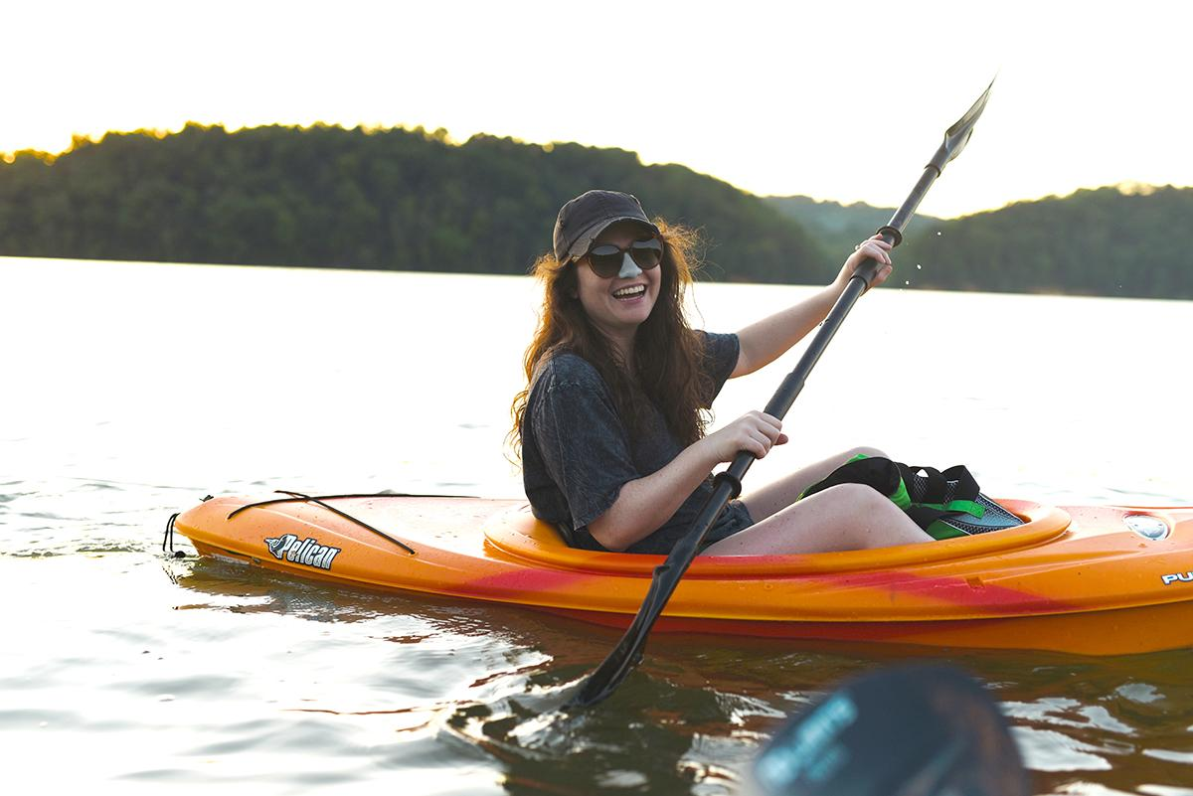
Brand Visuals - Photography
I chose an image of a woman outside having fun, wearing Nöz. I chose this image because I feel it perfectly represented the Nöz brand as it is fun and doesn’t feel forced. It also shows the product in use, which I feel proves that the product can be used in any outdoor setting.

Slide 7
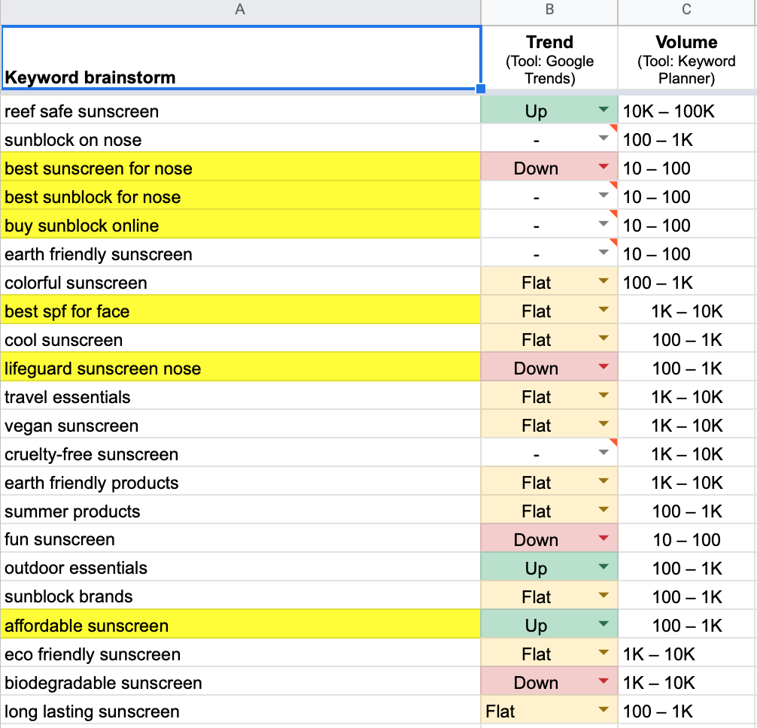
SEO - Keyword research
5 keywords for the site’s meta title
  Reef safe sunscreen
  Best spf for face
  Eco friendly sunscreen
  Environmentally safe sunscreen
  Zinc oxide sunscreen
I chose these keywords because I feel these words are angled towards my chosen customer persona and something he would search. I also chose a few of the keywords because they were trending up and had a higher volume than the rest.

Slide 8

SEO - Site Meta tags
A site’s meta title is important because it shows a site’s primary topic and what the site wants you to know about their product. It also increases clicks by using target keywords to attract customers.
Targeted keywords used for meta title
  Reef Safe Sunscreen
  Best SPF for face

Slide 9

Landing page optimization
CRO Strategies Used
  Bold, clear CTA button
  Featured Product
  Product Reviews
  Trust Badges
  Blog Posts
  Discount code displayed on top of homepage

Slide 10
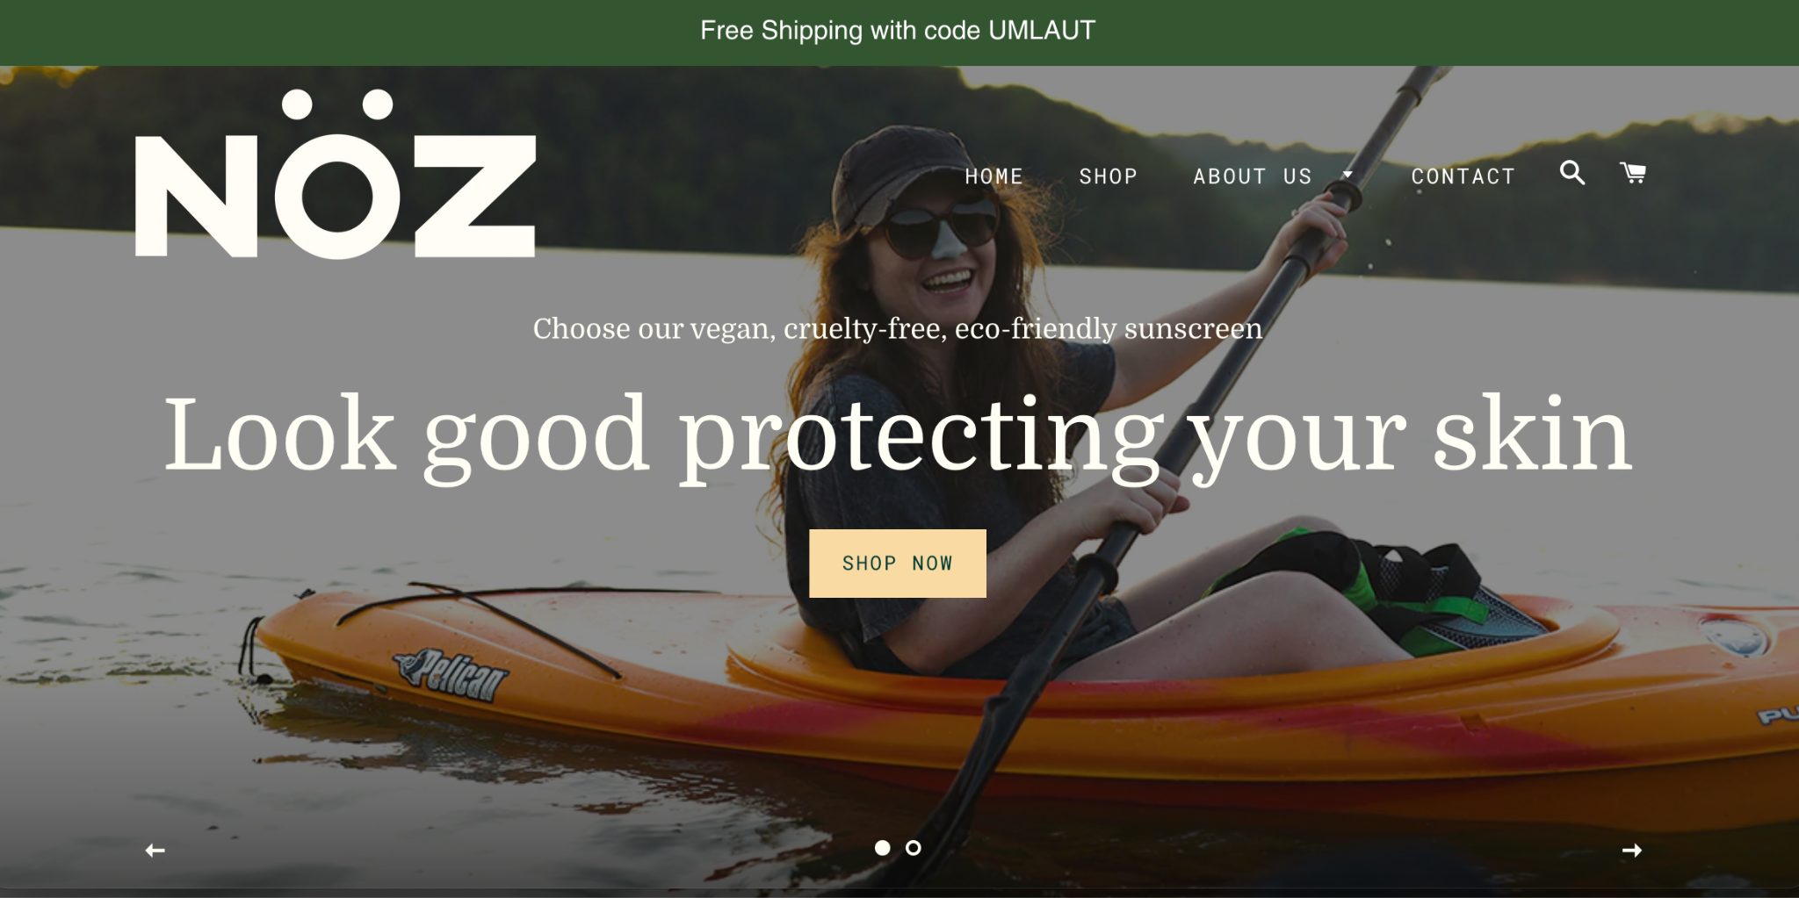
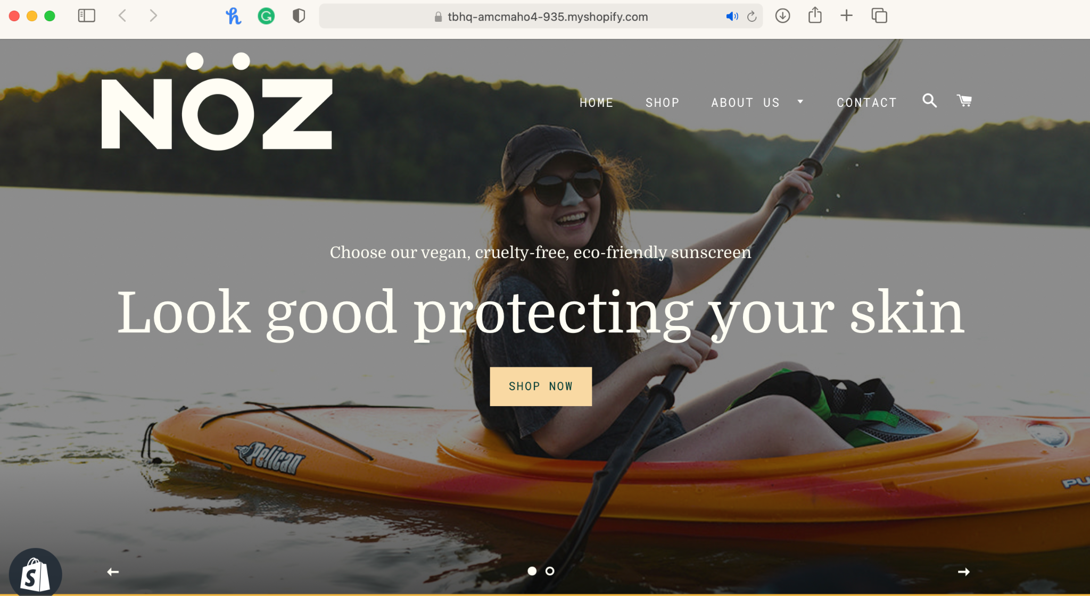
A/B Testing
If the homepage includes a free shipping discount code then sales will increase due to offering a promotion that will allow customers to save money and make customers more inclined to buy from the site.
Original:
Variant:

Slide 11
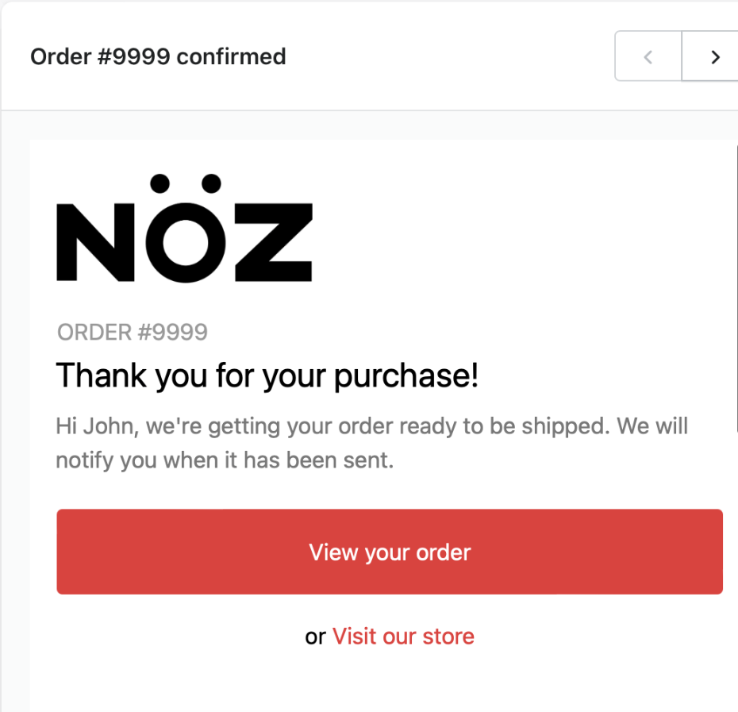
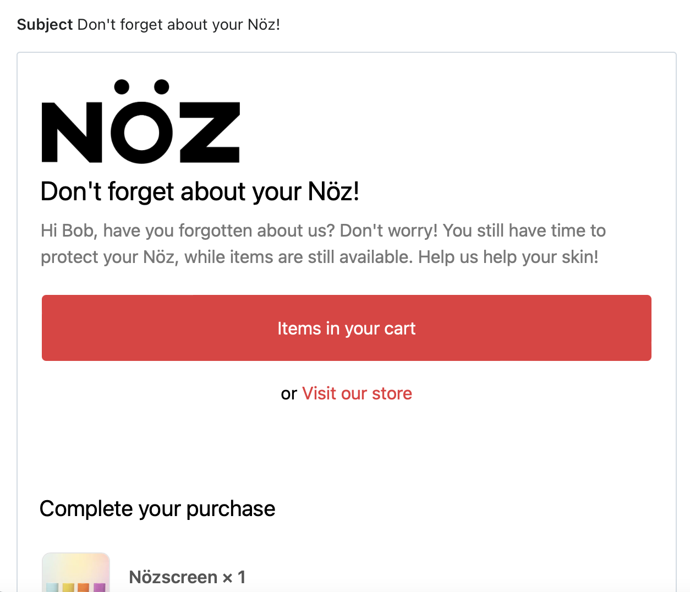
Email

Slide 12
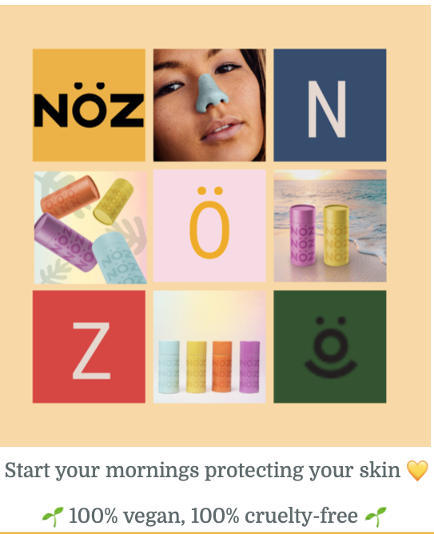
Instagram post

